Slide 1



Development of master curricula for natural disasters risk management in Western Balkan countries
Quality of engineering curricula and student evaluation
Dr. Maria Bakatsaki
Technical University of Crete, School of Production Engineering and Management, Chania, Greece
Fifth Quality Assurance Committee meeting/ 20th March 2019
Project number: 573806-EPP-1-2016-1-RS-EPPKA2-CBHE-JP
"This project has been funded with support from the European Commission. This publication reflects the views only of the author, and the Commission cannot be held responsible for any use which may be made of the information contained therein"

Slide 2
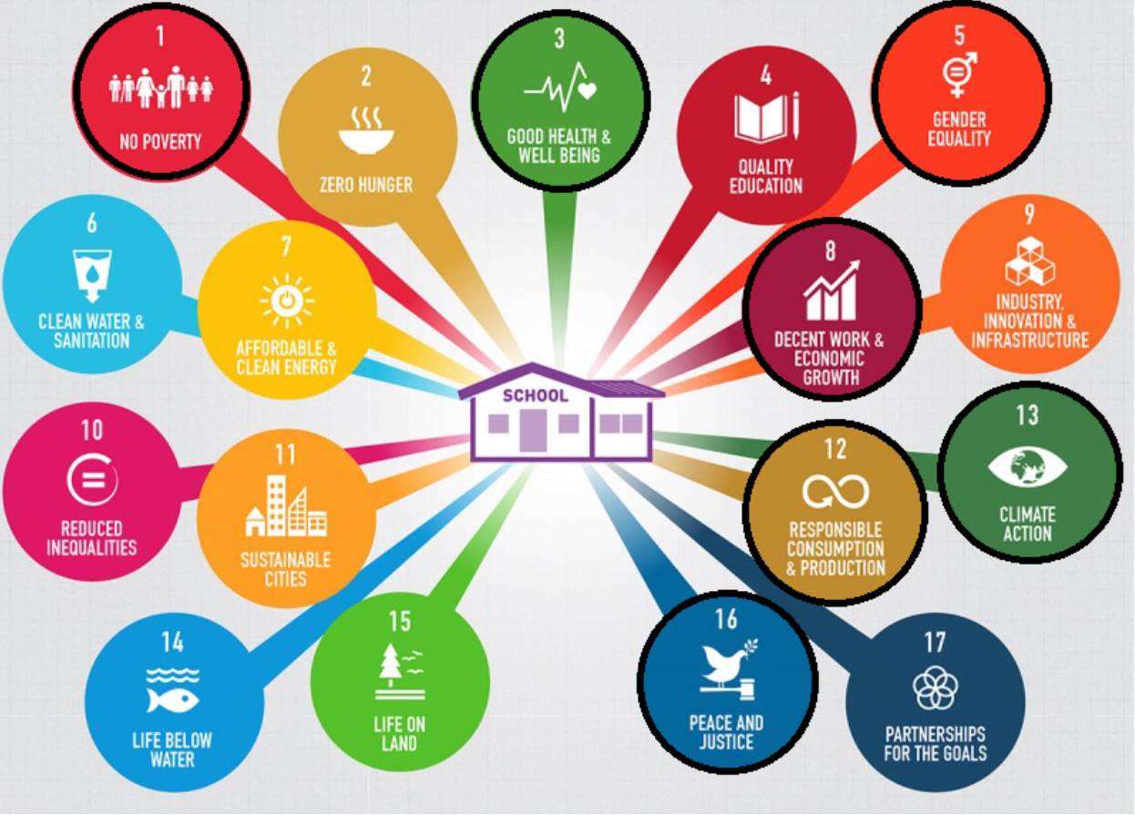
UNESCO’s “2030 Agenda for Sustainable Development” in HE-SDG4.3
Development of master curricula for natural disasters risk management in Western Balkan countries
Quality education accelerates progress towards the achievement of all of the SDGs
By 2030, ensure equal access for all women and men to affordable and quality technical, vocational and tertiary education, including university.”

Slide 3
UNESCO’s vision for HE
Development of master curricula for natural disasters risk management in Western Balkan countries
Tertiary education plays a vital role in:
imparting job skills
stimulating critical and creative thinking
generating and disseminating knowledge for social, cultural, ecological and economic development.
Educating future scientists, experts and leaders.
Through their research function, they play a fundamental role in creating knowledge and underpin the development of analytical and creative capacities that enable solutions to be found for local and global problems in all fields of sustainable development.

Slide 4
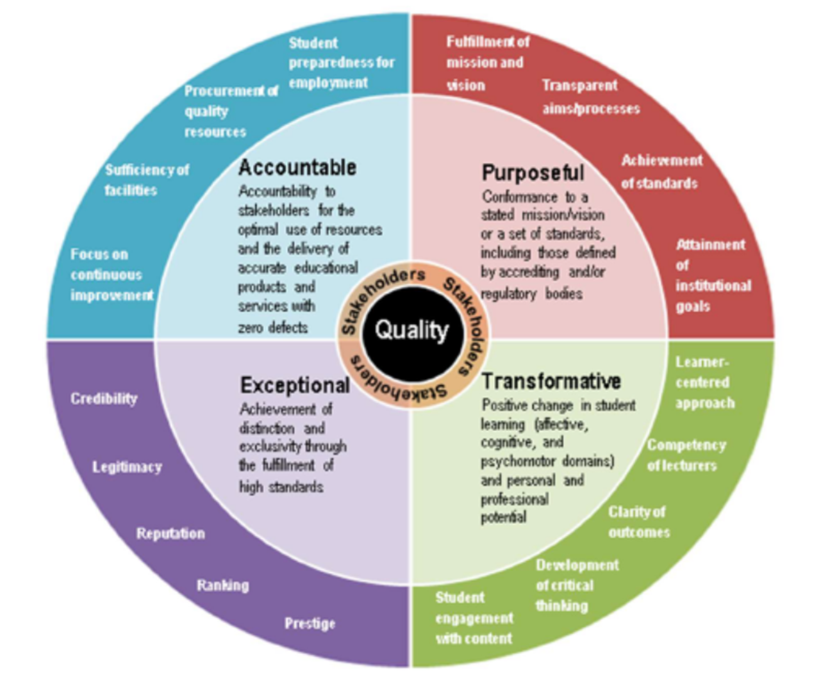
What is quality education in HE?
Development of master curricula for natural disasters risk management in Western Balkan countries
Source: Schindler et al., 2015

Slide 5
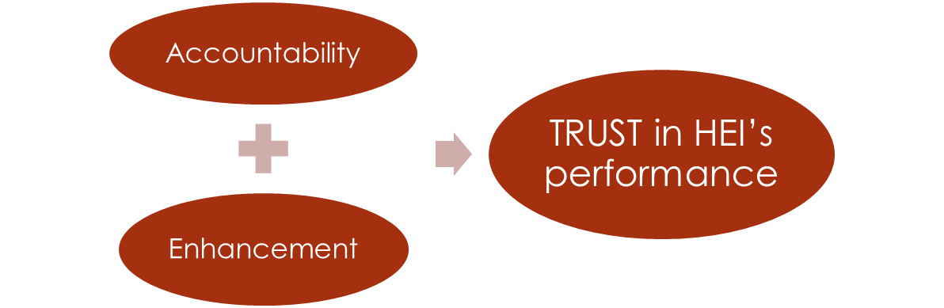
A successful implementation QA provide:
Development of master curricula for natural disasters risk management in Western Balkan countries
information to assure the higher education institution and the public of the quality of the higher education institution’s activities (accountability) as well as
provide advice and recommendations on how it might improve what it is doing (enhancement).
They can support the development of a quality culture that is embraced by all: from the students and academic staff to the institutional leadership and management.

Slide 6
NOT just Education for All BUT Student Success and ‘ready plus workers’
Development of master curricula for natural disasters risk management in Western Balkan countries
Student Success (Retention, attainment and progression)
Student success is a key element in which teaching quality, student satisfaction and the achievement of graduates are core to institutional success (Cole, 2018).
It is NOT tied to one rigid view of success of all
BUT rather providing some guiding principles whereby they might construct a more meaningful sense of student success for themselves.
NOT just ‘‘work ready’’: competencies (generic and job specific skills and knowledge) relevant to today.
BUT ‘work ready plus’: capabilities for not only today but for tomorrow – capabilities like the ability to manage the unexpected, remain calm and tolerate ambiguity.

Slide 7
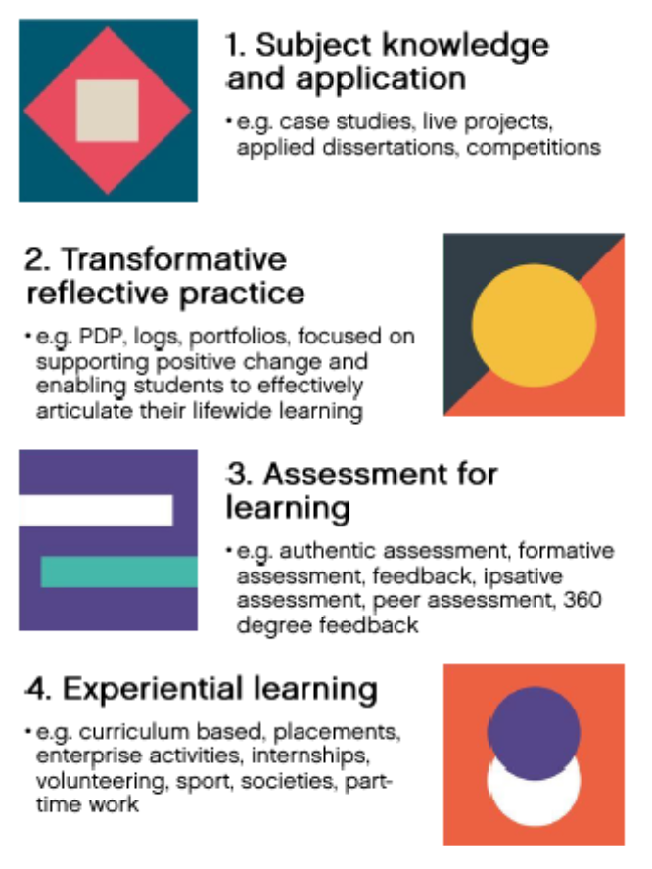
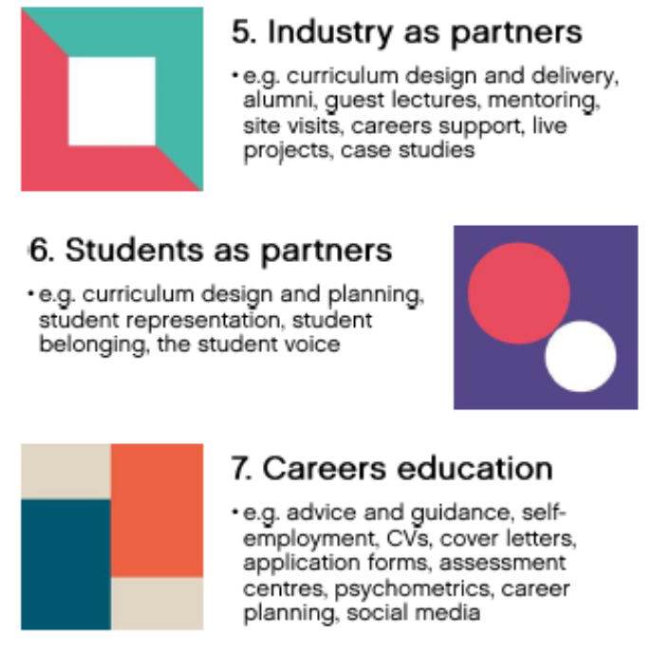
Cross thematic focus areas for Student Success
Development of master curricula for natural disasters risk management in Western Balkan countries
Source: Cole, 2018

Slide 8
The Student Success Framework
Development of master curricula for natural disasters risk management in Western Balkan countries
Source: Advance HE, 2017

Slide 9
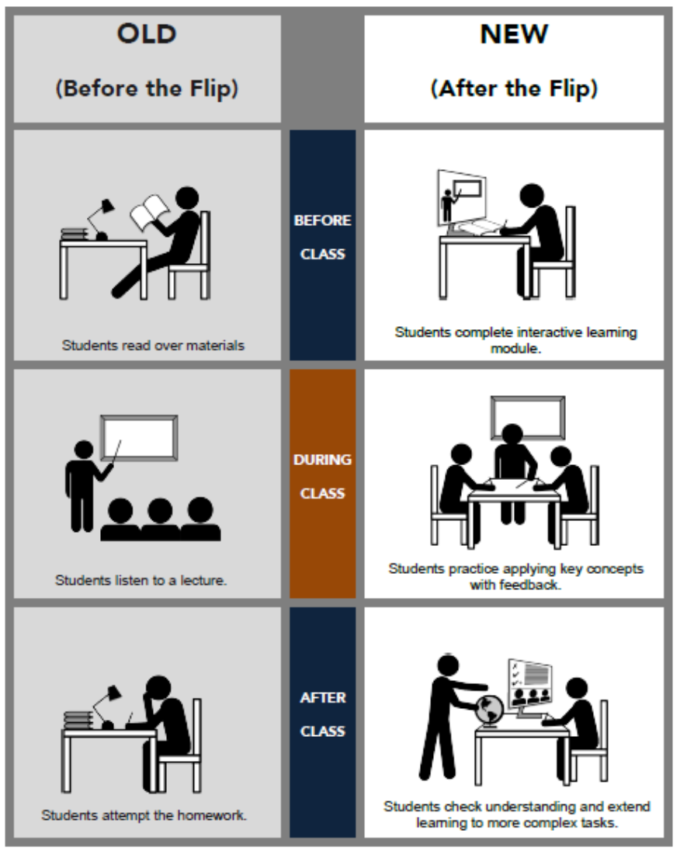
The Student Success Framework
Development of master curricula for natural disasters risk management in Western Balkan countries
Source: SOURCE: How do You Flip a Class? https://facultyinnovate.utexas.edu/how-to-flip

Slide 10
Bringing employability into internal QA(1/2)
Development of master curricula for natural disasters risk management in Western Balkan countries
Questions that might be directed to graduates about their experiences of higher education include:
Have you found the ‘right job’ for you?
How easy was it to find?
How well prepared were you for the job?
What knowledge and skills were needed?
What knowledge and skills were you lacking?
What do you think is going to be your next job?
How well prepared do you think you will be for it?
Do you think you would benefit from some additional education?
If so, what sort?

Slide 11
Bringing employability into internal QA (2/2)
Development of master curricula for natural disasters risk management in Western Balkan countries
Questions that might be directed to employers include:
What are you looking for when you recruit graduates?
Are you finding it?
How easy is it to find? And where?
What is lacking and/or needs improving?
What is changing in the world of work?
Will this mean that your future needs are going to be different from your present ones?

Slide 12
Student Evaluation
Development of master curricula for natural disasters risk management in Western Balkan countries
How can we build ‘ready plus workers’? Some examples of student evaluation:
Authentic Assessment (http://jfmueller.faculty.noctrl.edu/toolbox/whatisit.htm )
A school's mission is to develop productive citizens.
To be a productive citizen, an individual must be capable of performing meaningful tasks in the real world.
Therefore, schools must help students become proficient at performing the tasks they will encounter when they graduate.
To determine if it is successful, the school must then ask students to perform meaningful tasks that replicate real world challenges to see if students are capable of doing so.
Ipsative Assessment (https://iteachu.uaf.edu/ipsative-assessment/ )
It is the practice of determining a student’s progress based on their earlier work and reflects a “personal best” sense of progress that we see commonly in athletics.
Students assessed on academic work in this way experience “pride in their work,” and it “[helps] them take a longer term view of learning (Brown, S., & Knight, P. ,1998).

Slide 13
Student Evaluation
Traditional VS Authentic Assessment
Development of master curricula for natural disasters risk management in Western Balkan countries
Traditional Assessment | Authentic Assessment
Selecting a Response | Performing a Task
Contrived | Real-life
Recall/Recognition | Construction/Application
Teacher-structured | Student-structured
Indirect Evidence | Direct Evidence
The curriculum drives assessment | Assessment drives the curriculum
But an academic does not have to choose between AA and TA. It is likely that some mix of the two will best meet his needs.

Slide 14
Professional Capability Framework (1/4)
Development of master curricula for natural disasters risk management in Western Balkan countries
Student Evaluation
Source: Scott, G. (2016).

Slide 15
Table 1: Personal capability scales and items (2/4)
Development of master curricula for natural disasters risk management in Western Balkan countries
Student Evaluation
Scale | Item
Self-awareness | Deferring judgment and not jumping in too quickly to resolve a problem
 | Understanding my personal strengths and limitations
 | Being willing to face and learn from my errors
 | Bouncing back from adversity
 | Maintaining a good work / life balance and keeping things in perspective
 | Remaining calm under pressure or when things take an unexpected turn
Decisiveness | Being willing to take a hard decision
 | Being confident to take calculated risks
 | Tolerating ambiguity and uncertainty
 | Being true to one's personal values and ethics
Commitment | Having energy, passion and enthusiasm for my profession and role
 | Wanting to produce as good a job as possible
 | Being willing to take responsibility for projects and how they turn out
 | PA willingness to persevere when things are not working out as anticipated
 | Pitching in and undertaking menial tasks when needed

Slide 16
Table 2: Interpersonal capability scales and items (3/4)
Development of master curricula for natural disasters risk management in Western Balkan countries
Student Evaluation
Scale | Item
Influencing | Influencing people's behaviour and decision in effective ways
 | Understanding how the different groups that make up my university operate and influence different situations
 | Being able to work with senior staff within and beyond my organisation without being intimidated
 | Motivating others to achieve positive outcomes
 | Working constructively with people who are 'resistors' or are over-enthusiastic
 | Being able to develop and use networks of colleagues to solve key workplace problems
 | Giving and receiving constructive feedback to/from work colleagues and others
Empathising | Empathising and working productively with people from a wide range of backgrounds
 | Listening to different points of view before coming to a decision
 | The ability to empathise and work productively with people from a wide range of backgrounds
 | Being able to develop and contribute positively to team-based programs
 | Being transparent and honest in dealings with others

Slide 17
Table 3: Cognitive capability scales and items (4/4)
Development of master curricula for natural disasters risk management in Western Balkan countries
Student Evaluation
Scale | Item
Diagnosis | Diagnosing the underlying causes of a problem and taking appropriate action to address it
 | Recognising how seemingly unconnected activities are linked
 | Recognising patterns in a complex situation
 | Being able to identify the core issue from a mass of detail in any situation
Strategy | Seeing and then acting on an opportunity for a new direction
 | Tracing out and assessing the likely consequences of alternative courses of action
 | Using previous experience to figure out what's going on when a current situation takes an unexpected turn
 | Thinking creatively and laterally
 | Having a clear, justified and achievable direction in my area of responsibility
 | Seeing the best way to respond to a perplexing situation
 | Setting and justifying priorities for my daily work
Flexibility & Responsiveness | Adjusting a plan of action in response to problems that are identified during its implementation
 | Making sense of and learning from experience
 | Knowing that there is never a fixed set of steps for solving workplace problems

Slide 18
What means ‘ready plus workers’ for the natural disasters risk management?
Development of master curricula for natural disasters risk management in Western Balkan countries
Developing future leaders for business is quite different from developing socially-minded, civically-engaged, ethical leaders that serve others. (Buschlen, 2015).
Universities must NOT simply develop good managers following traditional learning methods (e.g. classroom lectures, internships)
BUT effective, collaborative, transformational and ethically-minded leaders and should push for more service-based endeavours from their students to provide leadership in practice, that is for a more SERVICE LEARNING experience.
The students must develop a portfolio full of both curricular and co-curricular leadership trainings focused on societal awareness, civic- engagement, multiculturalism, ethics and service-based philanthropy.
Notes:
The need for the latter pushes collegiate students beyond an academic experience by developing a portfolio full of both curricular and co-curricular leadership trainings focused on societal awareness, civic engagement, multiculturalism, ethics, and service-based philanthropy (Dugan, 2006). Leadership educators must not simply develop good managers, educators must develop effective, collaborative, transformational, and ethically-minded leaders (Komives et al., 2005); and universities should push for more service-based endeavors from their students to provide exposure to leadership in practice (Berger & Milem, 2002). A function of higher education programs is to create responsible citizens who are ready to contribute to leadership (Arnold & Welch, 2007; Buschlen & Dvorak, 2011).

Slide 19
What is ‘Learning Service’ experience?
Development of master curricula for natural disasters risk management in Western Balkan countries
Learning Service (SL) is the experience in which students:
participate in an organized service activity that meets identified community needs, and
reflect on the service activity in such a way as to gain further understanding of course content, a broader appreciation of the discipline, and an enhanced sense of personal values and civic responsibility.

Slide 20
What is LS for natural disasters management ?
Development of master curricula for natural disasters risk management in Western Balkan countries
The success of humanitarian relief:
Is NOT JUST strictly applying technical skills (e.g., delivery, installation, maintenance, programming)
BUT is often determined by leadership exercising interpersonal skills (e.g., listening, awareness, problem solving, persuasion, participation),
SL opportunities provide vital leadership and logistics practice while students provide humanitarian relief.
Higher Education institutions are uniquely positioned to provide this experience for students through both SL courses and through short- term immersion trips found in a co-curricular setting.

Slide 21
References and further reading
Development of master curricula for natural disasters risk management in Western Balkan countries
Brown, S., & Knight, P. (1998). Assessing learners in higher education. Teaching and Learning in Higher Education. London, UK: Routledge.
Buschlen, E., Warner, C. & Goeffnett, S. (2015). Leadership Education and Service:Exploring Transformational Learning Following a Tornado. Journal of Leadership Education, Winter 2015.
Cole, D. (2018). ‘Developing an integrated institutional approach to student success.’, https://www.heacademy.ac.uk/knowledge-hub/developing-integrated-institutional-approach-student-success
Faculty Innovation Center of the University of Texas at Austin, ‘How do You Flip a Class?’, https://facultyinnovate.utexas.edu/how-to-flip
Schindler, L., Puls-Elvidge, S., Welzant, H., & Crawford, L. (2015). Definitions of Quality in Higher Education: A Synthesis of the Literature. Higher Learning Research Communications, 5(3), 3. https://doi.org/10.18870/hlrc.v5i3.244.
Scott, G. (2016). ‘Assuring the quality of achievement standards and their valid assessment in Australian Higher Education. Final report to Australian Government, Department of Education and Training’, http://flipcurric.edu.au/ .
Thomas, L., Hill, M., O’Mahony, J., & Yorke, M. (2017). What works? Student Retention & Success-Supporting Student Success: Strategies for Institutional Change. Full report. London. Retrieved from https://www.phf.org.uk/wp-content/uploads/2017/04/Summary-report-final-no-crop-1.pdf
UNESCO (2016), ‘Education 2030: Incheon Declaration and Framework for Action for the implementation of Sustainable Development Goal 4: Ensure inclusive and equitable quality education and promote lifelong learning opportunities for all.’ https://unesdoc.unesco.org/ark:/48223/pf0000245656

